Slide 1
GeoKings
Team Members
Andrew Usvat
Zack Bryant
John Cardeccia
Jackson Brittain
Alex Poole
Client
United States Geological Survey (USGS), Astrogeology Science Center

Slide 2
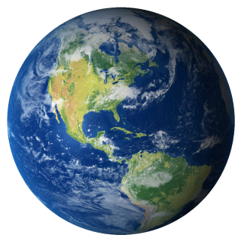
Big Picture
The universe extends over a radius of about 15 billion light years
We want to increase space exploration
Images and maps help increase exploration
1
https://www.google.com/url?sa=i&url=https%3A%2F%2Fwww.freeiconspng.com%2Fimages%2Fearth-png&psig=AOvVaw1

Slide 3
Clients
usgs.gov
Amy Stamile Dr. Jay Laura Trent Hare
Software Developer Software Lead Cartographer
2

Slide 4
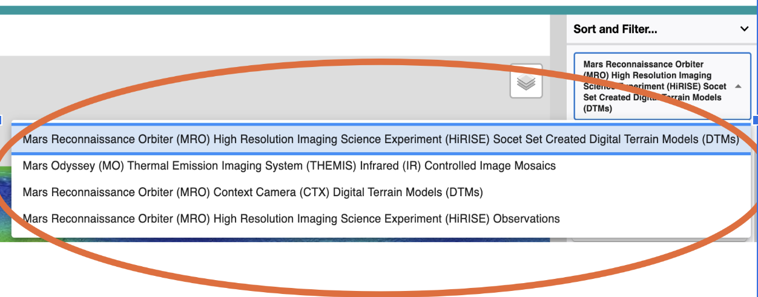
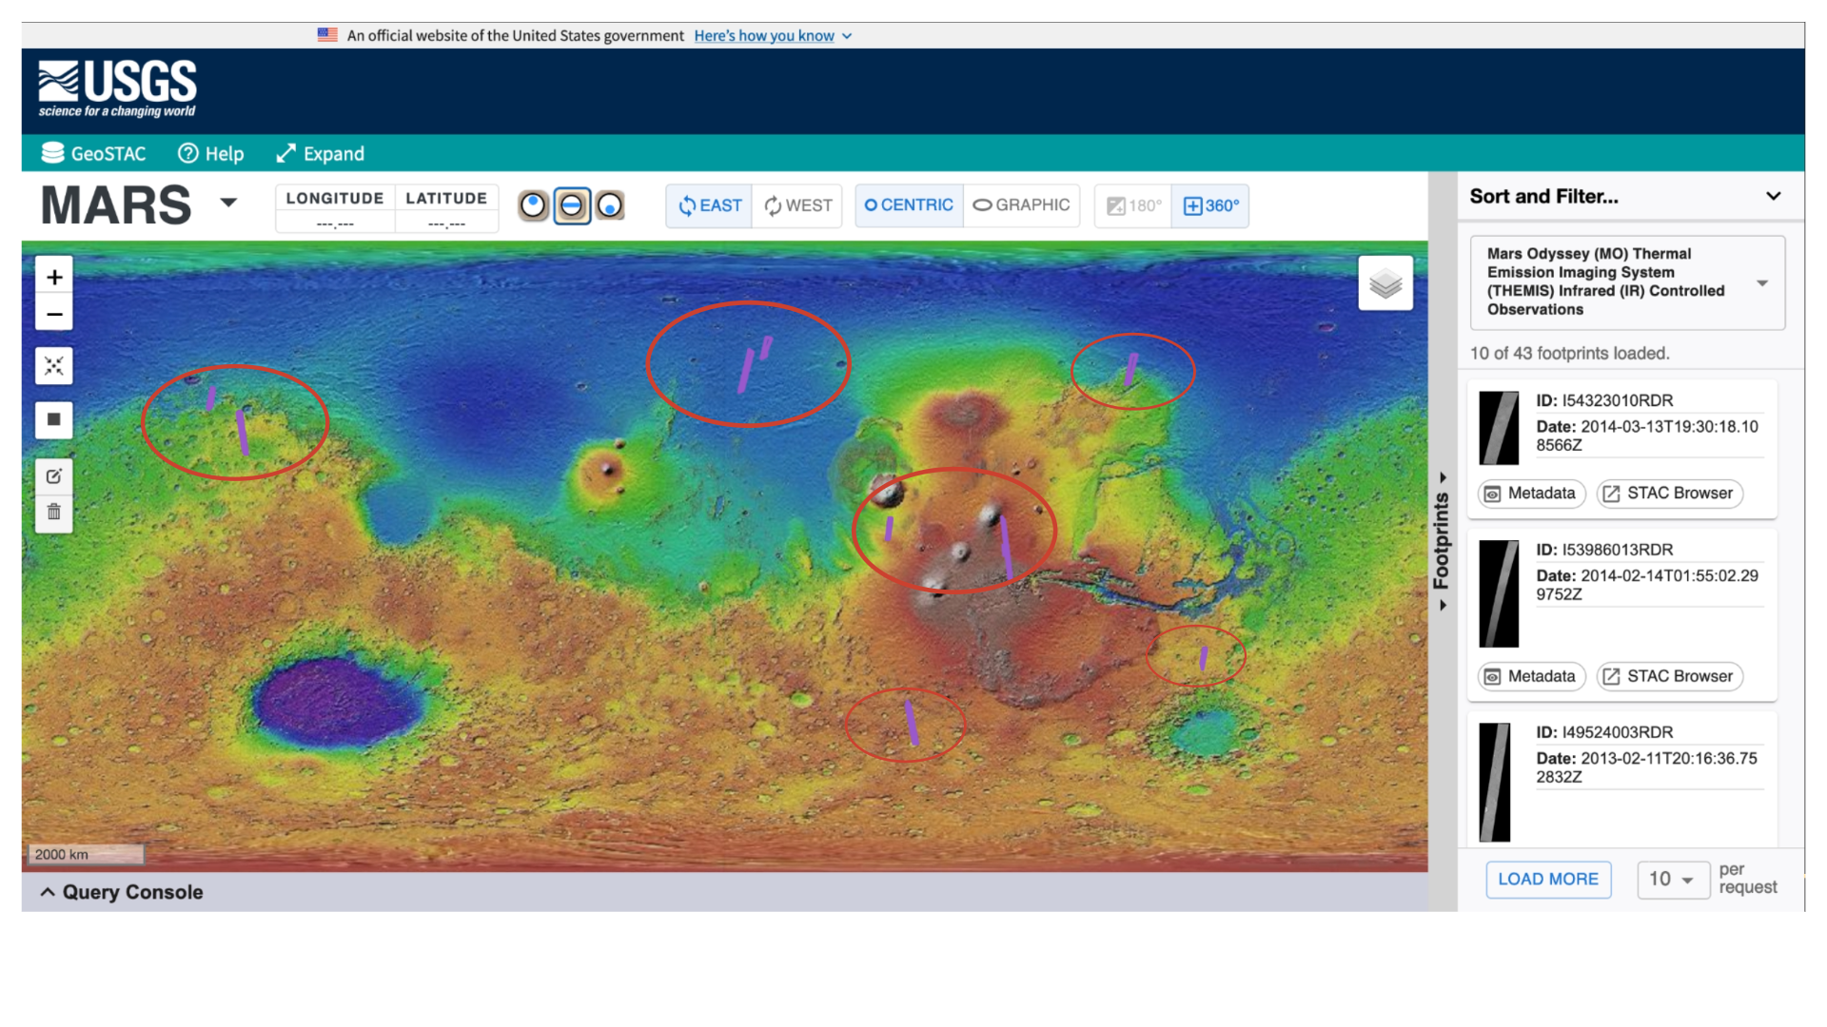
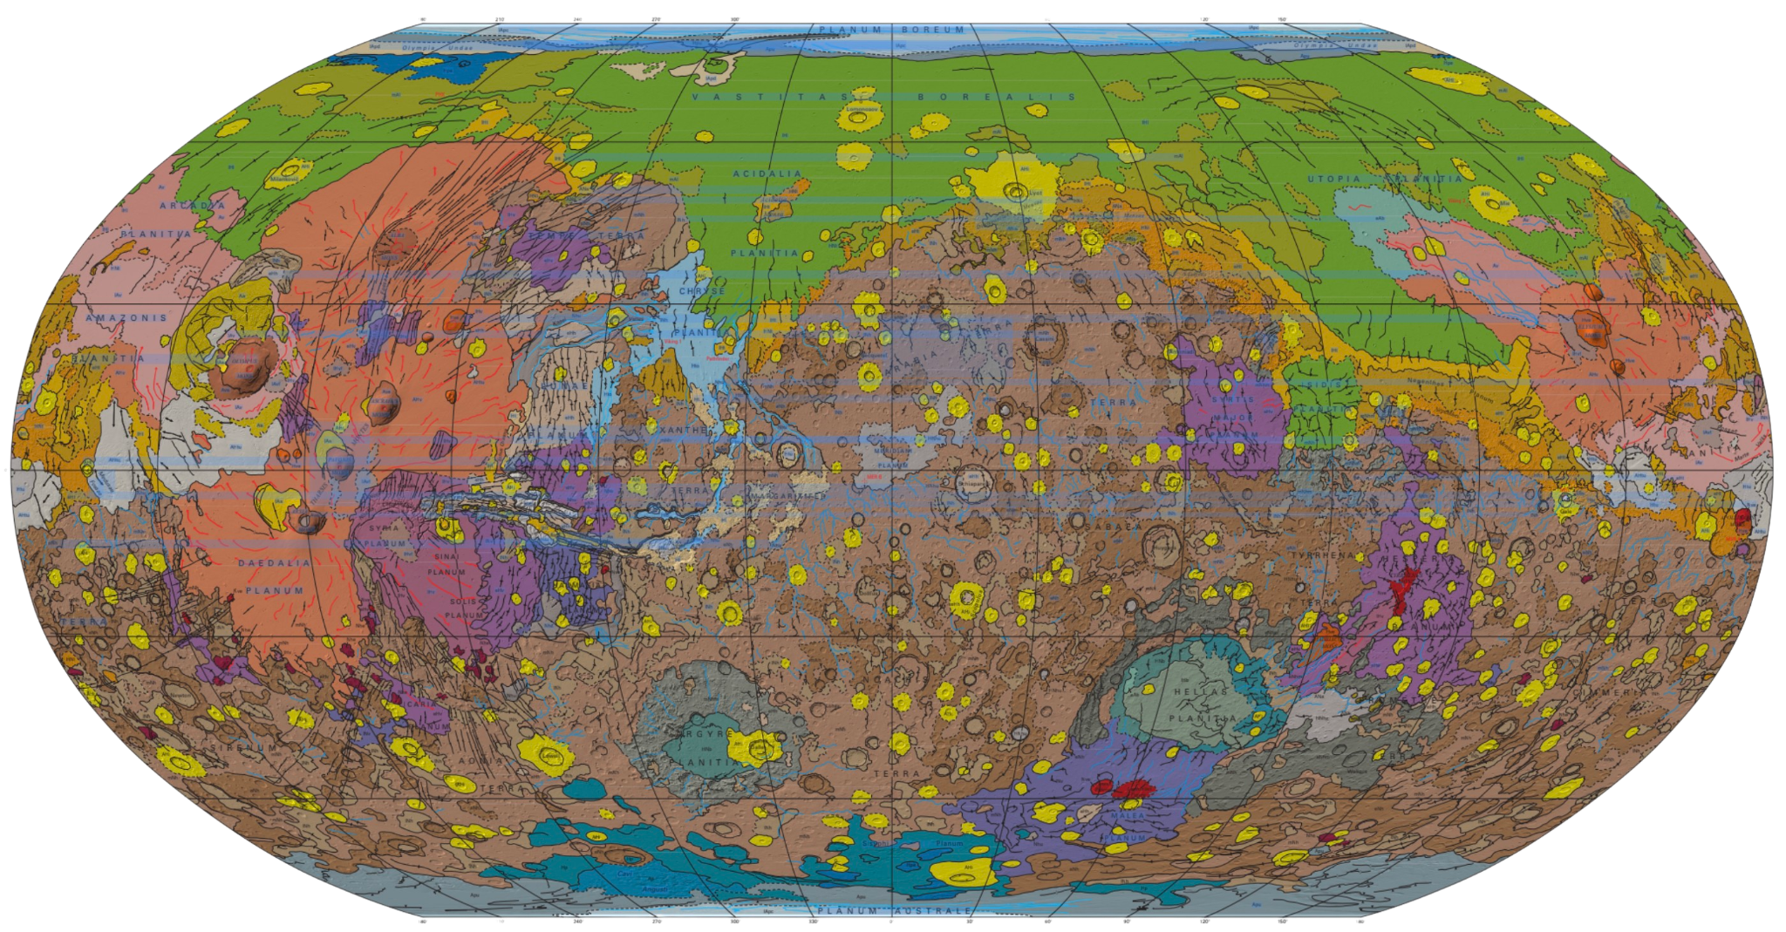
Problem
The current application uses only raster data.
Vector data is available but is not currently being used.
Stylization of footprints is currently very limited.
Raster (current)
vs
Vector
3
https://stac.astrogeology.usgs.gov/geostac/

Slide 5
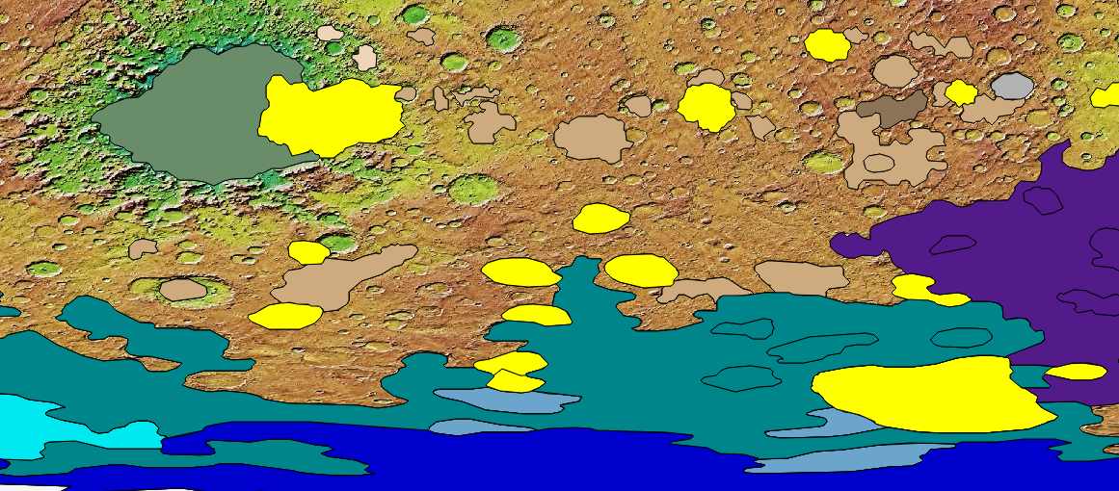
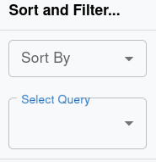
Solution
Integrating the the Vector API into GeoSTAC using PyGeo API software, and modifying the existing tools to work with the Vector API
Using Leaflet to display vectors and Leaflet.SLD to style them
Creating compatibility with ElasticSearch and displaying to the website using React
Map stylized with feature colors
4
Query selection box

Slide 6
Implementation Overview
(Requirements)
Rendering
Styling
Searching
Access GeoJSON data through vector API
Using SLD and SVG files to make the data useful
Making the data accessible for the users
5

Slide 7
Technologies
6

Slide 8
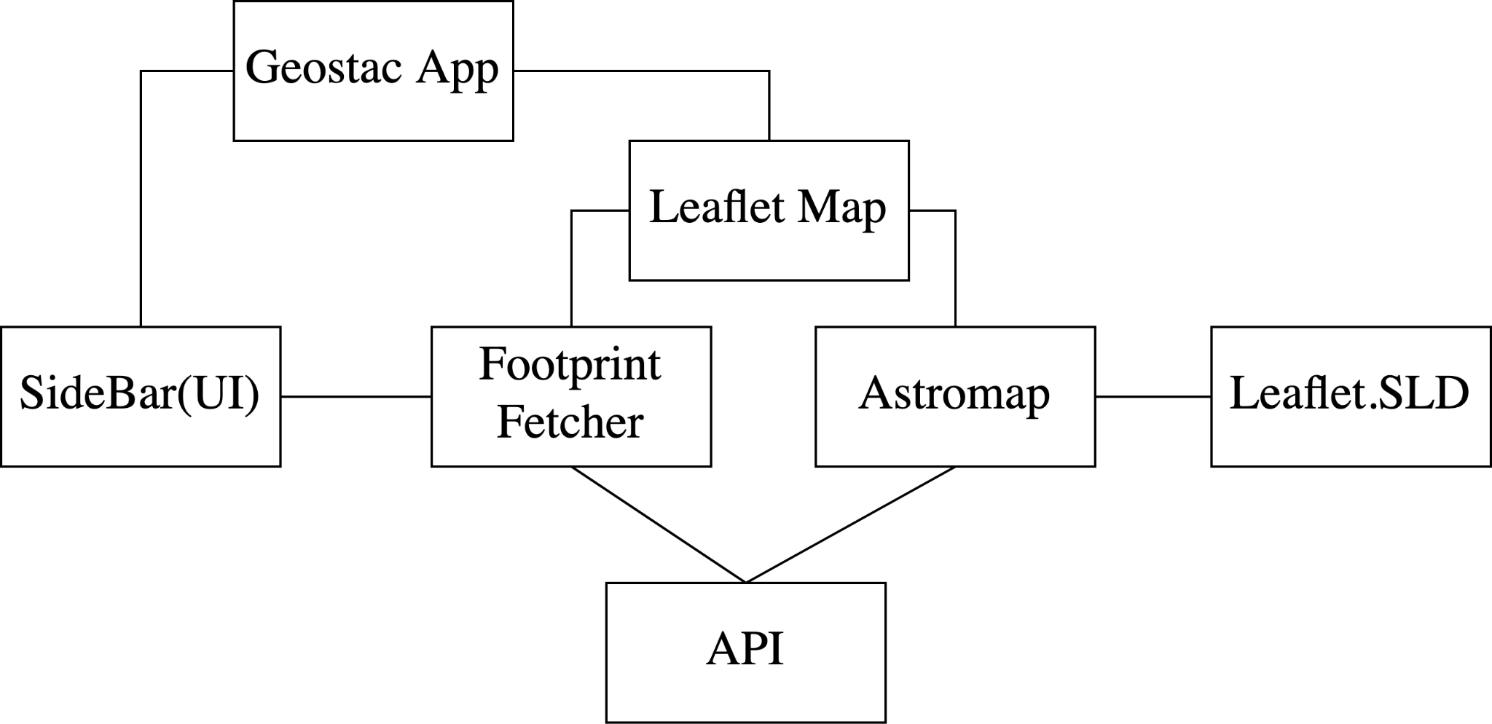
Architecture
7

Slide 9
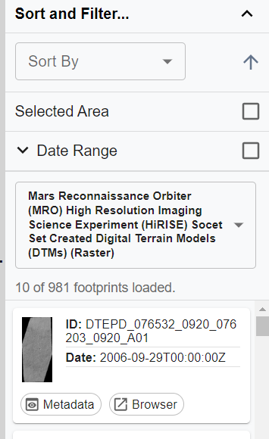
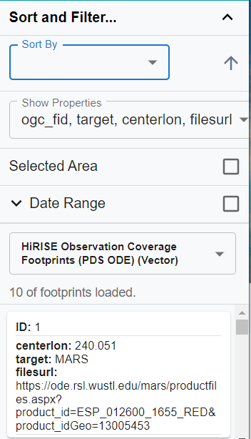
Implementation of API and searching
Raster Collection
Vector Collection
8

Slide 10
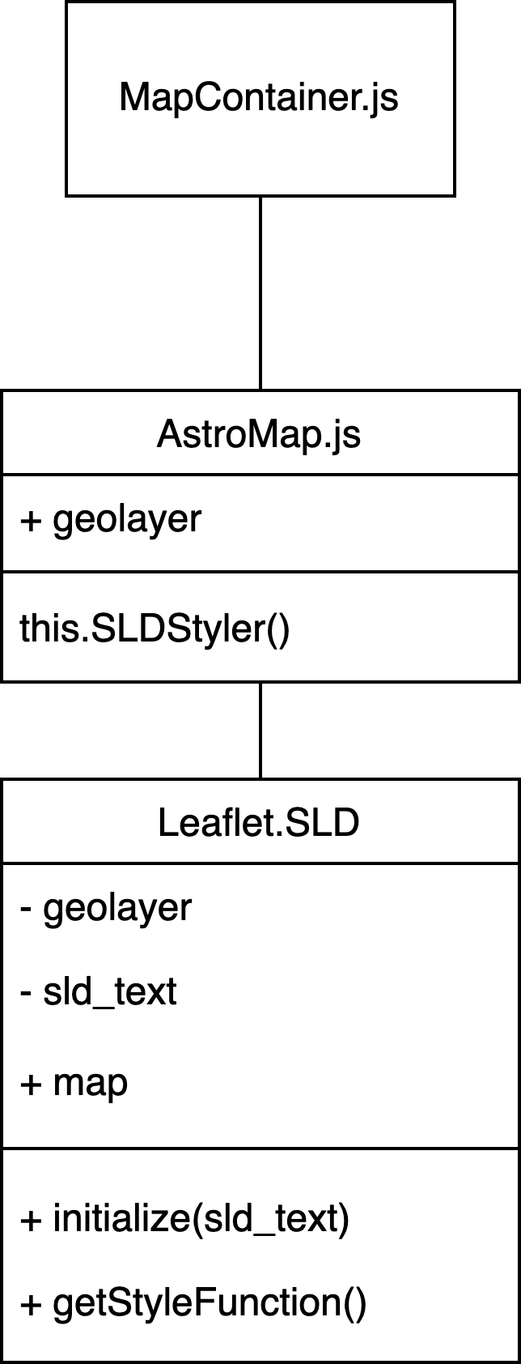
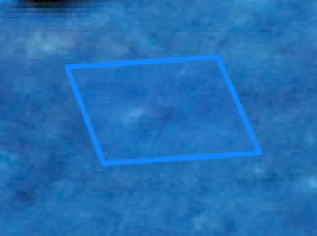
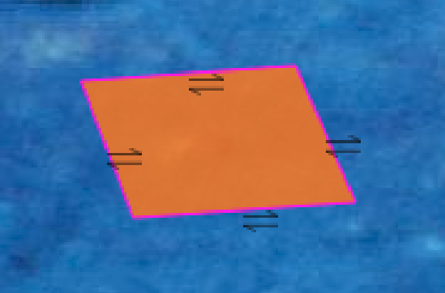
Implementation of Stylizing & Rendering
- Default GeoJSON style
- Custom GeoJSON styling with symbology
9

Slide 11
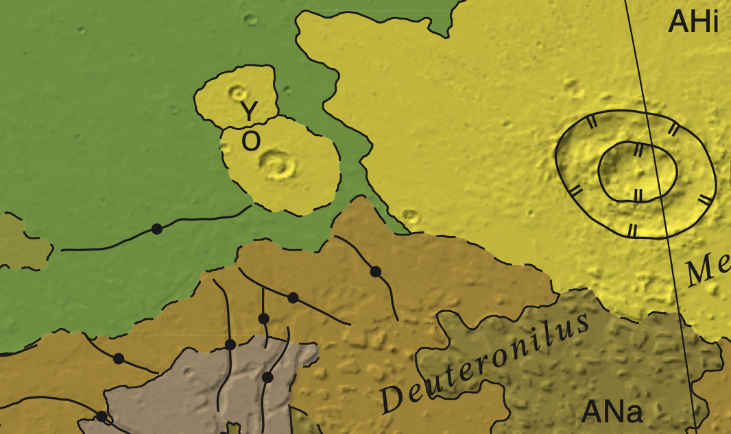
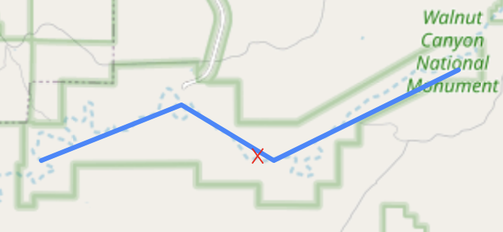
Implementation of Stylizing cont.
- Ideal symbol placement for lines and polygons
Polygon:
Find midpoint between two adjacent points and store this in an array
Multiline:
Found the midpoint by taking the total line distance divide by two. Then travel that distance to the midpoint along the line
- Symbol placed on midpoint polygon line
- Symbol placed on midpoint of multiline
10

Slide 12
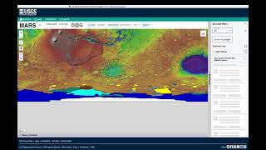
Prototype Review
11

Slide 13
Challenges and Resolutions
Licensing:
Challenge
MIT Vs Public domain
Leaflet.SLD is under an MIT license
Resolution
Node.js
Icon symbology:
Challenge
FGCD compliant symbology
SVG Images
Resolution
SLD files
symbol library
SLD file fetch:
Challenge
Hosting Locally
flexible / user interactions
Resolution
Host SLD files on external server
12

Slide 14
Schedule
13

Slide 15
Testing Plan
45%
15%
Unit Testing:
Mainly testing SLD.Styler for good, missing and bad data
Integration Testing:
Testing how the Pygeo API works with GeoSTAC
User Testing:
In person testing with a survey to gauge the user’s experience
14

Slide 16
Future Work
User defined SLD files
Ability to download features
15

Slide 17
Conclusion
Functional Requirements:
Rendering, Styling, Searching
Implementation:
Rendering
GeoJSON files using Vector API
Styling
Modified Leaflet.SLD functionality
Searching
Filterable attributes
Challenges/Resolution:
Licensing, Icon Symbology, SLD File Fetch
16

